Slide 1
UQ Pipeline Components Tutorial: Bayesian theory and application to the analytic Hill function
Kevin Driver and Sara Cheng
October 2020

Slide 2
Outline
Introduction Fundamental Bayesian Theory
A refresher on conditional probability
Bayes theorem
Bayesian inference
Likelihood model form
UQ Pipeline Components
Steps of a UQ workflow
Hill Function example (Thanks to Scott Brandon and Andrew Fillmore)
Analytic slice plots
Surrogate model and slice plots
Markov Chain Monte Carlo (MCMC)
Posterior UQ Analysis

Slide 3
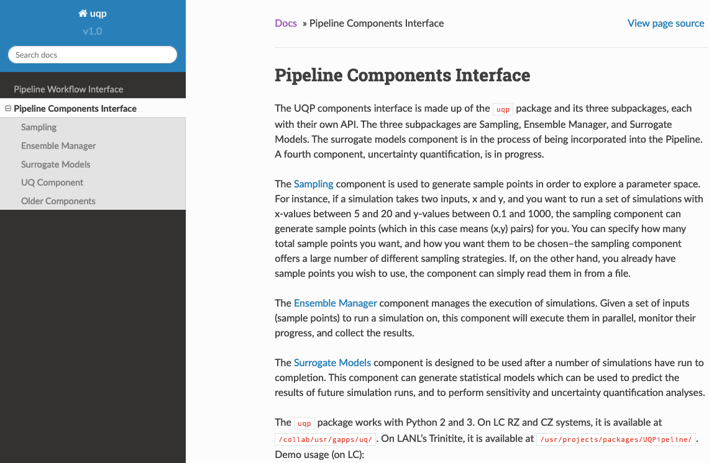
Audience: This is a tutorial for beginners learning to use the new UQ pipeline component interface
Guide written for new users, especially those who have
Never used a large-scale workflow tool and
Have no knowledge of Bayesian inference
I found there are several phases to learning the UQP:
1) Building the UQP script components
See developers: David Domyancic, Andew Fillmore,
James Corbett, Francisco Beltran, Scott Brandon
and documentation: https://rzlc.llnl.gov/uqp/docs/
2) Learning Bayesian theory and connecting that to what the components are doing
Use Coursera:
a)Bayesian Statistics: From Concepts to Data Analysis (fundamental theory)
b)Bayesian Statistics: Techniques and Models (MCMC modeling and regression)
and also textbooks, data Science websites, wikipedia and UQ talks
3) Run UQP; perform and understand the UQ analysis
Work through the Hill Function example; translate to other examples
4) Build dexterity running large-scale workflows

Slide 4
Benefits of using the LLNL UQ Pipeline components and areas for improvement
1) On-site development team tailoring components to many lab-specific missions.
CS support for bugs and implementation of custom features.
2) Implementing the surrogate model and MCMC is just a few
lines of python code.
3) UQP library contains functionality to do UQ analysis and has built-in plotting
routines to examine quantities of interest.
4) On-site subject-matter expert (ensembles, surrogates, MCMC, UQ) support.
Some areas for improvement:
1) Documentation. The current documentation is largely syntax-oriented and not
particularly new-user friendly (hence, this tutorial walkthrough).
2) Deployment of updates & new documentation can be slow.

Slide 5

Introduction: Joint Probability
Uncertainty quantification of a model is generally concerned with conditional
probabilities, i.e. not independent events, because an experiment (E) and a model (M)
have a joint probability distribution (“the probability of E and M”):
Universe
Experiment
$$P\left(E∩M\right)$$
Model
(parameters)

Slide 6
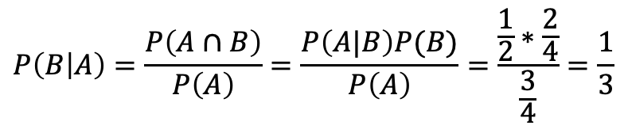
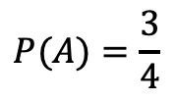
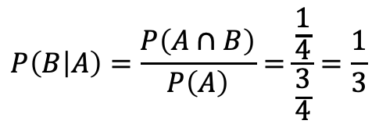
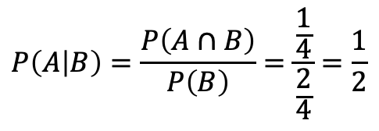
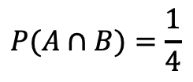
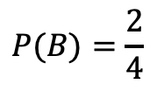
Conditional Probabilities: a discrete refresher example
A and B
Independent and joint probabilities:
$$P(A)=\frac{3}{4}$$
$$P(B)=\frac{2}{4}$$
$$P(A∩B)=\frac{1}{4}$$
Conditional probabilities:
$$P\left(A | B\right)=\frac{P\left(A∩B\right)}{P\left(B\right)}=\frac{\frac{1}{4}}{\frac{2}{4}}=\frac{1}{2}$$
A
B
$$P\left(B | A\right)=\frac{P\left(A∩B\right)}{P\left(A\right)}=\frac{\frac{1}{4}}{\frac{3}{4}}=\frac{1}{3}$$
Preview of Bayes’ theorem:
$$P\left(B | A\right)=\frac{P\left(A∩B\right)}{P\left(A\right)}=\frac{P\left(A|B\right)P(B)}{P\left(A\right)}=\frac{\frac{1}{2}∗\frac{2}{4}}{\frac{3}{4}}=\frac{1}{3}$$

Slide 7
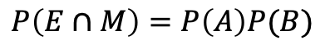
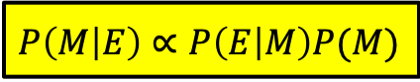
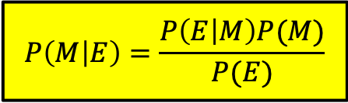
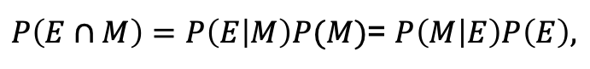
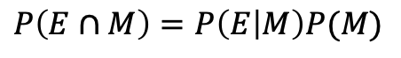
Defining Bayes Theorem
Bayes theorem comes from the law of conditional probabilities:
If E, M independent:
$$P\left(E∩M\right)=P\left(A\right)P(B)$$
(probability of A and B when P(A) is independent from P(B))
If E conditional on M:
$$P\left(E∩M\right)=P\left(E | M\right)P(M)$$
(probability of A and B when P(A) is conditional on P(B))
By symmetry,
$P\left(E∩M\right)=P\left(E | M\right)P(M)$= $P\left(M | E\right)P\left(E\right),$
which is Bayes theorem:
The normalization often isn’t necessary,
so one often sees this written as a proportionality:
$$P\left(M | E\right)=\frac{P\left(E | M\right)P(M)}{P(E)}$$
$P\left(M | E\right)∝$ $P\left(E | M\right)P(M)$
In words:
Given a prior state of knowledge, P(M), Bayes theorem allows us get an updated
state of knowledge, P(M|E), based on newly acquired evidence, P(E|M).
Note: Hence, P(M) is called the prior and P(M|E) is called the posterior. The posterior
can then be used as a new prior when additional evidence comes to light.

Slide 8
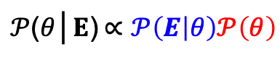
Bayesian inference: Using Bayes’ theorem to update prior beliefs
Posterior distribution
Likelihood distribution
Prior distribution
(Note: We use a
proportionality symbol to
ignore the marginalization
factor)
$$𝒫\left(params | measurement\right)∝ 𝒫\left(measurement | params\right)𝒫\left(params\right)$$
$𝒫$($θ$│$E$)$∝𝒫\left(E | θ\right)𝒫\left(θ\right)$
, where E=experimental data and 𝜃=model parameters.
Prior is an educated guess at the distribution of the uncertainty in the simulation
input parameters.
Likelihood is the probability of a measurement for a given set of input parameter values.
This is commonly approximated as a Gaussian (x=measurement, 𝜇=model prediction,
and 𝜎=measurement error). See slide 7 for model form.
Together, the likelihood is said to “calibrate” (or “update” or “filter”) the prior parameter
distribution based on the experimental data, giving the Posterior (joint distribution).
This process of updating the probability using data is known as Bayesian Inference.
Further analysis of the posterior provides an updated uncertainty on the input
parameters and the cumulative propagated error on the simulation output.

Slide 9
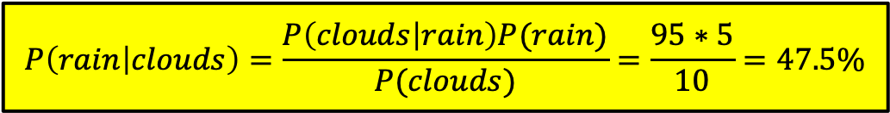
Conceptual example of Bayesian inference
What is the probability of rain in Livermore?
Based on general experience, we might guess:
P(rain) = 5% (probability of rain any given day in a year is low)
Now, if we look outside and see clouds, how would you update your chance for rain?
We can estimate that P(Clouds| rain) = 95% (probability of clouds when it rains),
and, P(Clouds) = 10% (probability that any given day happens to be cloudy in a year)
$$P\left(rain | clouds\right)=\frac{P\left(clouds | rain\right)P(rain)}{P(clouds)}=\frac{95∗5}{10}=47.5\%$$
Recap:
By gathering the evidence of clouds, we updated our over-generalized prior probability
and inferred that the chance of rain is actually much higher today.

Slide 10
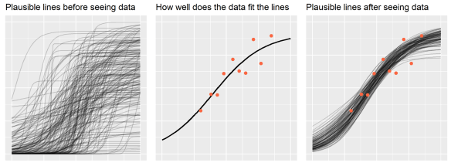
Pictorial illustration of Bayesian modeling with probability distribution functions
The posterior combines the likelihood (parameterized by observed data) and the prior,
updating the probability distribution that we use for making inferences. These usually
take the form of probability distribution functions, which we sample.
Posterior
(updated prior)
samples
Prior
samples
Observe New
Data
Reference: https://www.tjmahr.com/bayes-theorem-in-three-panels/

Slide 11
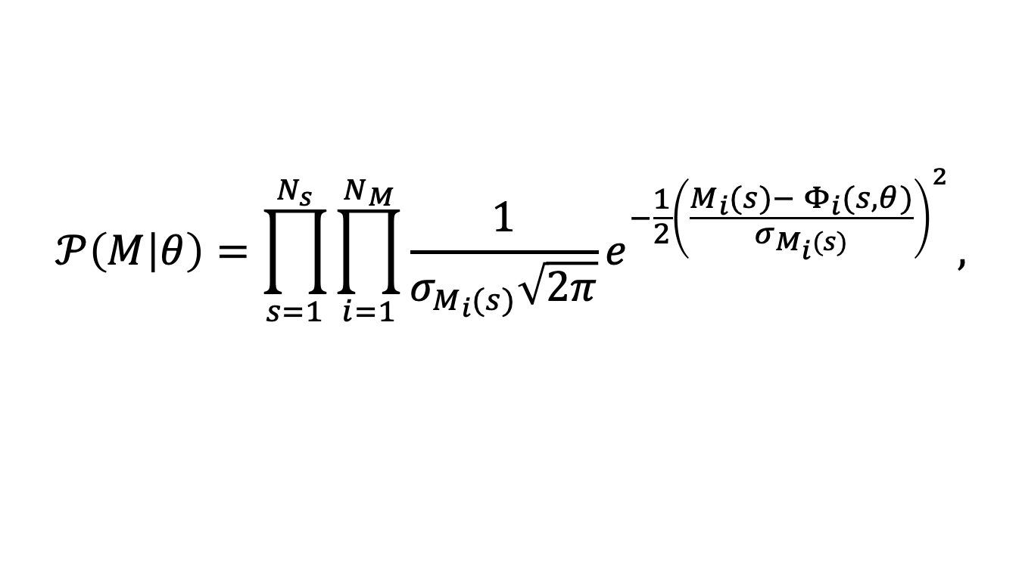
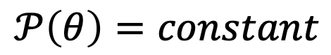
Model forms of the likelihood and prior for uncertainties that follow independent, Gaussian distributions
Deviation between a measurement
and a model prediction
Likelihood distribution
$$𝒫\left(M | θ\right)=\prod_{s=1}^{N_{s}}{\prod_{i=1}^{N_{M}}{{\frac{1}{σ_{M_{i}(s)}\sqrt{2π}}e}^{−\frac{1}{2}{\left(\frac{M_{i}(s)− Φ_{i}(s,θ)}{σ_{M_{i}(s)}}\right)}^{2}}},}$$
where M_{i} is a measured value, 𝛷(𝜃_{i}) is the model prediction using parameter set 𝜃,
N_{M} is the total number of measured experimental observables (e.g., ICF yields, Dante-1
and Dante-2 fluxes, breakout times, shock velocities) and N_{s} is some number of experimental
setup variations (e.g. gas-fills, densities, laser powers, thicknesses, or blocking washers, etc.).
Also, note that a product of Gaussians is still a Gaussian, just in a higher dimensional space.
Prior distribution
The prior is a distribution that describes your knowledge of parameter uncertainty.
Often one uses a uniform prior, indicating the distribution is unknown:
$$𝒫\left(θ\right)=constant$$

Slide 12
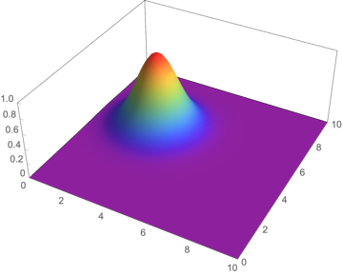
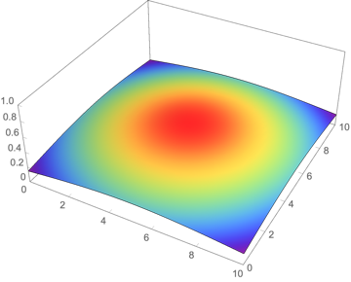
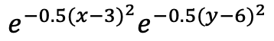
3D Gaussian pictorial illustration of Bayesian modeling
Consider a two-experiment likelihood and prior:
Likelihood “probability of a measured value given
values of the model parameters”
Prior “probability of the parameter values”
$$e^{−0.5{(x−3)}^{2}}e^{−0.5{(y−6)}^{2}}$$
Parameter y
y
Parameter x
x
A Gaussian peaked at mean experimental values
of x=3 and y=6. If the parameters are such that the model
matches experiment, i.e. (x-3)=0, (y-6)=0, then the peak value
is returned. If there is a large deviation between experiment
and the model, then a low, tail value, is returned.
A prior belief of the parameter distribution might
be that it is uniform or nearly uniform. Here,
I plot a broad, nearly flat Gaussian centered at (5,5)
as a prior distribution.

Slide 13
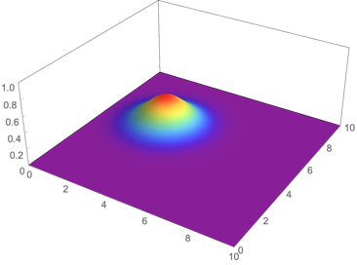
3D Gaussian pictorial illustration of Bayesian modeling
Multiply the likelihood and prior to get the posterior:
Likelihood
Prior
Posterior (new prior)
∝
y
y
y
x
x
x
Our prior distribution is significantly updated by the likelihood. The posterior distribution is still a Gaussian that is centered now peaked near the experimental values (3,6).
Note that our posterior will generally be a Gaussian for Gaussian or uniform priors, since
the product Gaussians is a Gaussian (look up conjugate prior for more info on thoughtful prior choices)

Slide 14
Motivation: What questions should I be asking about the UQ of my experiments and simulations?
What is the error on the experimental result? (hopefully, accurately measured)
What is the error on my simulation input parameters? (priors)
Over what value range will my simulation parameters produce a match to
the experimental result within its uncertainty? (posterior)
What is the total, propagated error bar on my simulated result? (posterior analysis)
What can I learn from posterior predictions of new data? (Posterior predictive)

Slide 15
More motivation: Why is UQ worth a designer’s time?
Bayesian inference is a statistical approach to determine model parameter uncertainty
by constraining your beliefs with experimental data, as opposed to just simply
using an intuitive guess or doing one-at-a-time sensitivity studies and naively propagating
uncertainties in quadrature.
Some examples:
1)Most people believe their opacity uncertainty is probably +/-20% based on lore.
A UQ analysis of, say, burn through experiments can provide data-driven constraints on the opacity
uncertainly.
2)My mix model length scale probably should be somewhere between 0.01-10um.
With UQ analysis, data can be used to find a range is consistent with experimental uncertainty.
3)My simulated flux error is probably 10-20% based on one-at-a-time sensitivity studies.
A UQ analysis can better constrain this error estimate based on the measured data.

Slide 16
The steps of a UQ Pipeline study workflow
[Step 1]: Acquire measured data and error bars, {y, 𝜎_{y}} from your experiment.
[Step 2]: Use the ensemble manager (THEMIS) to run simulations of the experiment by varying parameters with prior assumptions {a+/- 𝜎_{a}, b+/- 𝜎_{b}, c+/- 𝜎_{y}}, producing outputs {y+/- 𝜎_{r}}.
[Step 3]: Build a robust surrogate model, trained over the ensemble simulation input and output data: {a,b,c}, {y}.
[Step 4]: Construct a likelihood function for measurements given simulation predictions. Use the surrogate model in an MCMC algorithm to sample the (likelihood)(prior), which gives the posterior distribution (i.e. updated prior).
[Step 5]: Analyze the posterior distribution and use it to predict (posterior predictive) the updated parameter uncertainties and total uncertainly.
Each of these steps is worked through in the following slides for a simple, analytic example.

Slide 17
A UQ Pipeline workflow example: The Hill function
As a simple example of the entire UQ Pipeline workflow, I explore the analytic Hill
Function study that was developed by Scott Brandon and Andrew Fillmore:
The list of scripts for this example are as follows:
Script Name | Description
hill_slice_plot.py | Creates a 2D slice plots of the analytic Hill function
hill_surrogate.py | Creates a surrogate model for the Hill function
hill_sm_plot.py | Creates 2D slice plots of the Hill surrogate model
hill_anal_mcmc.py | Use MCMC to sample the posterior and determine its distribution properties
hill_anal_post.py | Analyzes the posterior predictions using the MCMC output
hill_sm_toSilo.py | Converts a surrogate model into a VisIt silo file

Slide 18
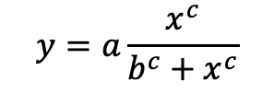
[Step 1] Collect a set of experimental measurements with error bars
Hill Function
Simulation parameters: {a,b,c}
Result: y
Value of x is fixed for each experiment (no uncertainty)
$$y=a\frac{x^{c}}{b^{c}+x^{c}}$$
11 Experimental Data Points
x | y± 𝜎
1.7995 | 3.4459
0.83629 | 2.7616
2.3971 | 3.0697
2.2857 | 3.4208
1.1870 | 2.9719
1.9797 | 3.1330
1.2773 | 3.5070
1.3973 | 3.0320
0.64994 | 1.4260
1.1062 | 3.3516
1.0851 | 3.4861
Experimental Measurements – For the Hill Function
UQ study, we assume 11 analytic solutions to the
Hill function as our “experimental data points.”
The experiments are labeled as a01—a11
in the scripts and assume an error bar of 𝜎=5%
on the measurements (y).

Slide 19
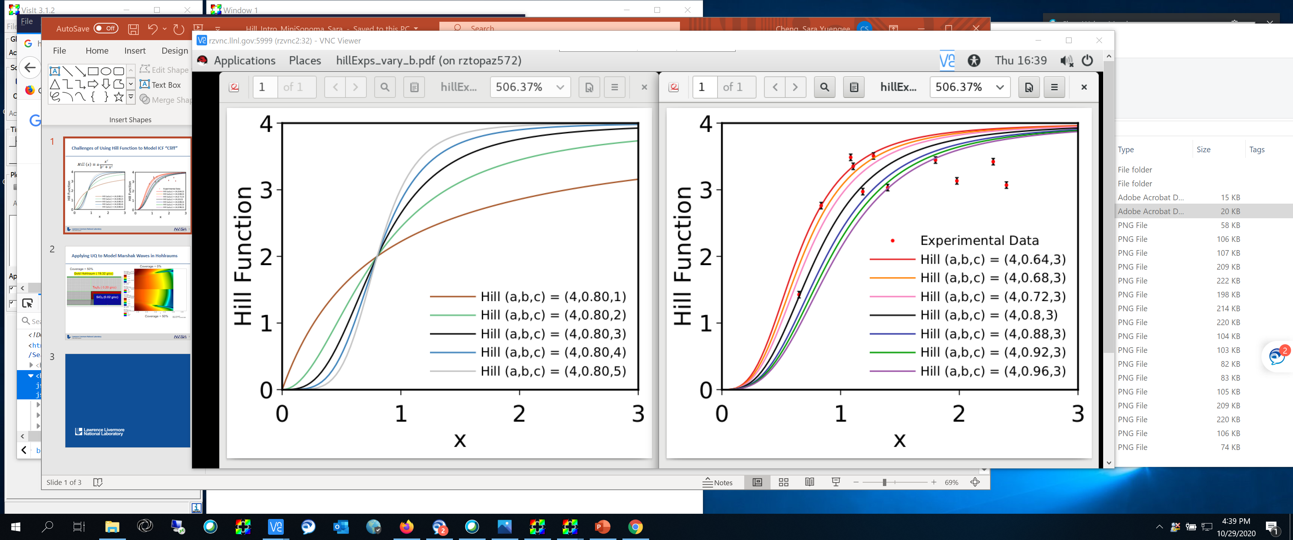
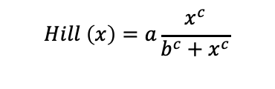
Challenges of Using Hill Function to Model an ICF “Cliff”
Sensitivity of Slope of Hill to c
Sensitivity of Slope of Hill to b
$$Hill \left(x\right)=a\frac{x^{c}}{b^{c}+x^{c}}$$
Note that since “c” is the Hill exponent, it controls the slope of the “cliff.” Adjusting c can produce fits to data with
nearly degenerate likelihoods by balancing the outliers of noisy data different ways. This makes a Bayesian inference for c difficult to converge and the Hill function a worthwhile tutorial exercise. This can result in a multi-mode posterior for c even though the likelihood is purely Gaussian.

Slide 20
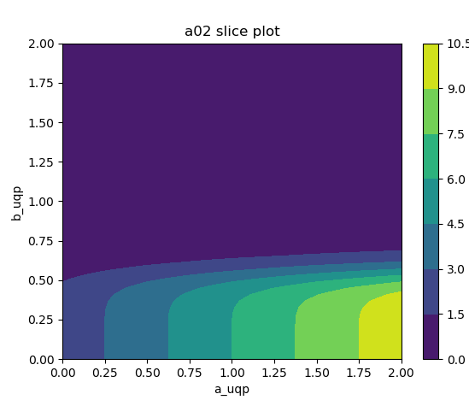
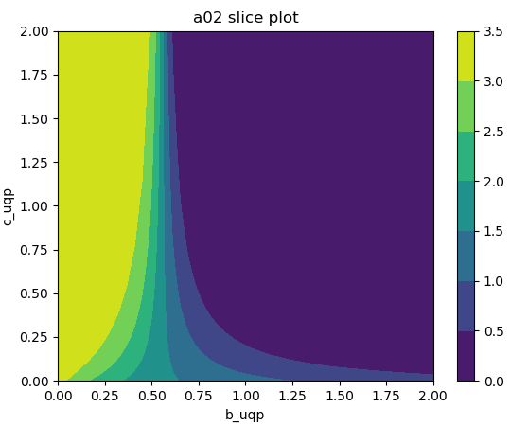
[Step 1, cont.] hill_slice_plot.py creates 2D slice plots of the “experimental data” which will validate the surrogate model slices later
These are contour plots (2D histogram plots) showing correlation among the Hill function
parameters {a,b,c}. Here, I just show two from experiment “a02” as an example. Similar
plots can be produced for each predefined “Hill experiment: a01—a11.”

Slide 21
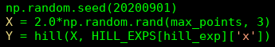
[Step 2] Generating an ensemble of simulated data (hill_surrogate.py)
Generate Ensemble of data: Generally this is an involved step that requires hooking up
the ensemble manager to a code, but for the Hill function, since it is an analytic function,
the ensemble generation step is trivial.
Inside hill_surrogate.py, I generate a random set of, say 1000, parameters {a,b,c},
for each experiment and compute the Hill function at the appropriate fixed value of x:
(X is an mx3 array)
(Y is the hill() function evaluation mx1 array)
In more complex simulations, one needs to perform an ensemble of batch simulations.
The UQ Pipeline has the ensemble manager, (aka,Themis), to manage this workflow.
Although, it’s not needed for this simple Hill example, I will show an example
ensemble manager script on the next few slides that can be used for such studies.

Slide 22
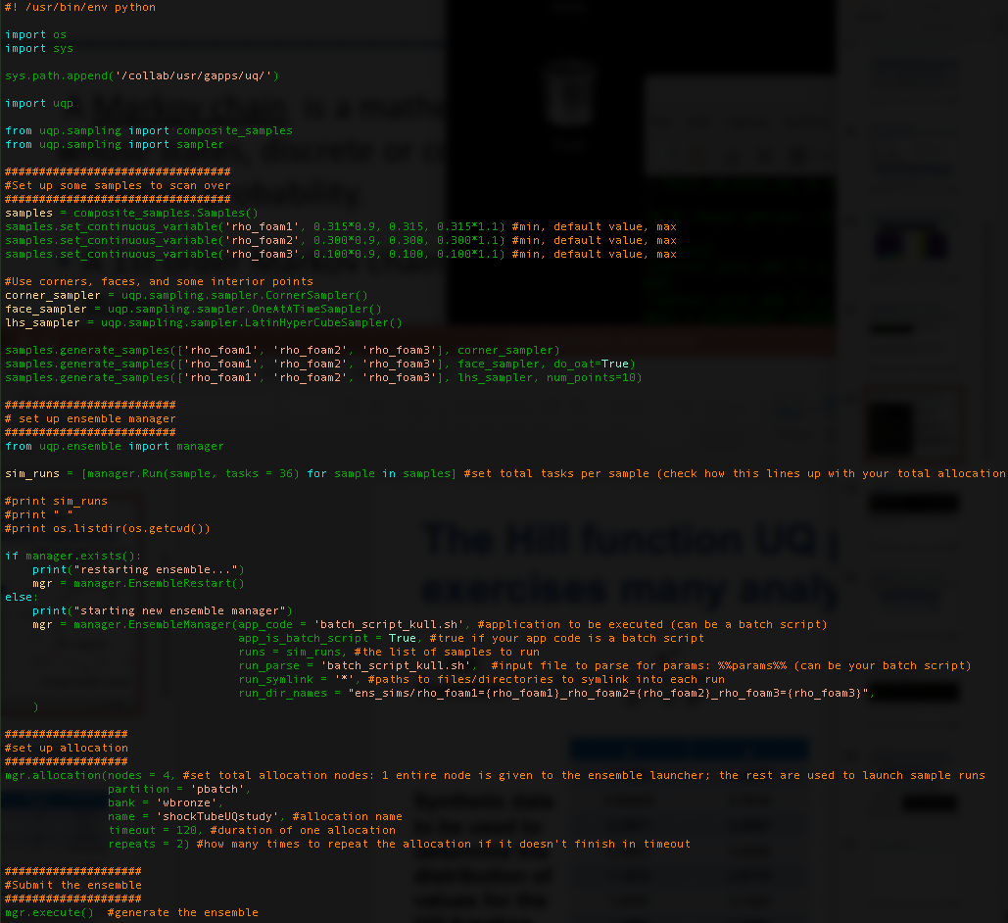
[Step 2, cont.] Example of an ensemble manager workflow script that uses a batch file (not needed for Hill example)
Import UQP
Specify some parameters to scan over
1)Specify variable names
2)Generate variable values (samples)
Ensemble Manager (create manager):
1)Specify total tasks per sample (here I use 36 because
there are 36 cores/node and I only plan to run 1 job per node)
2)Specify a batch script →see next slide for example
3)Specify run directory names
Specify the total allocation – the idea is to grab one large
allocation and run as many jobs as we can within that allocation,
as opposed to submitting all the jobs to queue separately.
The ensemble manager uses 1 node
So if I set nodes=4, I will have 3 free nodes to run jobs. Since
I only need 1 node for each job, I can run 3 jobs in parallel.
execute

Slide 23
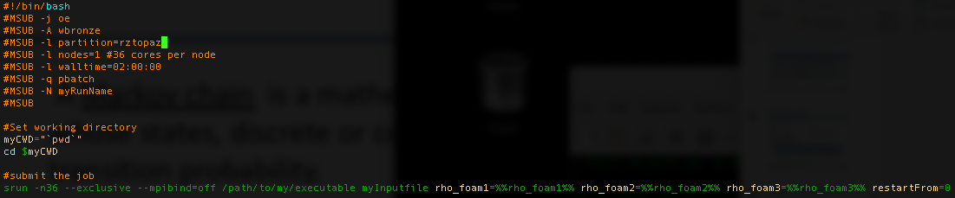
[Step 2, cont.] An example batch script to work with the ensemble manager (not needed for Hill example)
The batch script is typical except we have now put the variables we defined in the command line
using %%myVariable%% syntax. Our codes typically read variables from the command line, so this
is a convenient way of doing it. The ensemble manager will fill the variables with values as each
sample is launched.

Slide 24
[Step 2, cont.] Themis – the ensemble manager’s command-line interface (not needed for Hill example)
Themis is an alias of the uqp ensemble code:
alias themis=‘python /collab/usr/gapps/uq/uqp/ensemble’
Use “themis --help” to see options and information.
Instead of using the ensemble script, the same set up can be done from the
command line, assuming you created a csv file with samples in it:
>themis create runscript samples.csv -b -n 36 --parse inputFile
>themis allocation -N 4 -p pbatch -b wbronze -m myName
>themis dryrun 0
>themis execute
>themis progress –v #summary of progress
>themis display 0 10 –s #table showing progress status

Slide 25
[Step 2, cont.] Include any necessary information about prior assumptions in sample generation (hill_surrogate.py)
Prior assumptions*: Before generating the ensemble of simulations, we make
assumptions about the appropriate uncertainty (distribution) range of each input
parameter. For this exercise, we assume these ranges:
variable | Minimum value | Maximum value | distribution
a | 2 | 10 | uniform
b | 0 | 3 | uniform
c | 1 | 20 | uniform
x | 0 | 3 | environmental
*The actual prior function itself will be specified later on in the Monte Carlo
component.

Slide 26
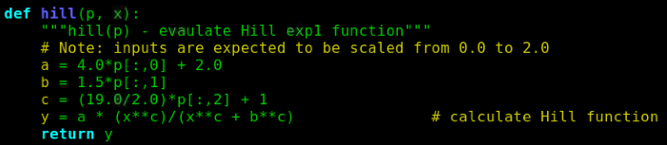
[Step 2, cont.] In the script, notice the Hill function parameters are scaled to achieve the desired prior ranges in this example
All {a,b,c} parameters are in the range {0,2}, but are scaled to a:{2,10}, b:{0,3}, c:{1,20}
inside the defined Hill function. This scaling is aesthetic choice; it’s not required for any
particular reason.

Slide 27
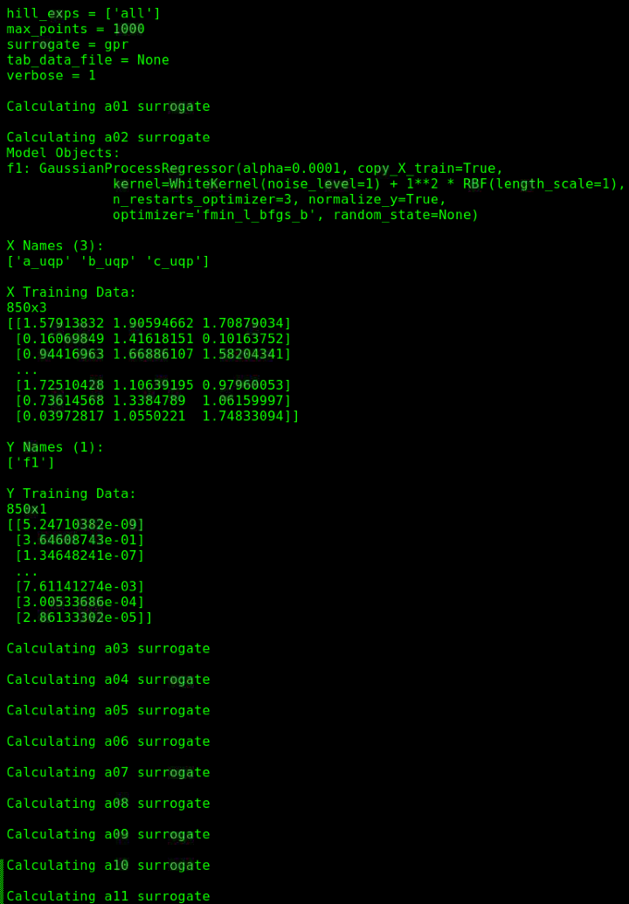
[Step 3] Generate surrogate model on a training data set for each experiment (hill_surrogate.py)
Generate the surrogate model:
Examine the command-line output
“-s gpr” asks for a Gaussian Process Regression model, which we see confirmed here in the
verbose (-v) generation output.
“-m 1000” asks for 1000 training data points and we hold out 15% for testing. So we can see
here there are 850 X (input) data and 850 y (output) data.
“-p all” generates and saves a surrogate model for each experiment separately,
which each correspond to a different value of x.
I will elaborate more on the ensemble generation and
the surrogate model in the coming slides…

Slide 28
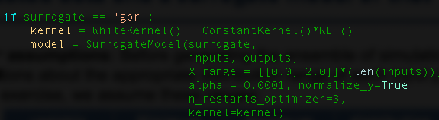
[Step 3, cont.] More detail regarding the surrogate model (hill_surrogate.py)
A surrogate model is a regression model that learns an input-output mapping.
The basic syntax in the UQ Pipeline takes a model form, the input variables, and output variable: SurrogateModel(‘model form’, [‘X1’, ‘X2’, ‘X3’], [‘Y’])
In our example, we have1000 {a,b,c} inputs,1000 {y} outputs, and hold out 15%, {a,b,c}_{test} to test the surrogate model for each experiment. This corresponds to a 1000x3 array and a 1000x1 array in total.
One can choose from many supervised learning models; we use Gaussian Process
Regression in this example:

Slide 29
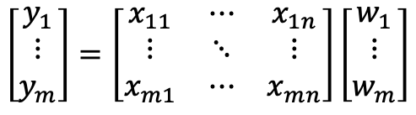
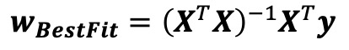
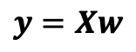
[Step 3, cont.] A simple example of how a linear regression surrogate model works for intuition’s sake
A surrogate model is simply a fit to the data. It can be quite sophisticated in general, but
suppose we think fitting a linear function to our data is a good surrogate model for the data. Then
linear regression would provide a suitable mapping of inputs to outputs.
m training examples: (x_{i},y_{i}), where y_{i} are the observed (output) values (we have m=1000)
n input variables (aka, features): x_{i} = [x_{i1},x_{i2},…,x_{in}]; in our Hill example this is our [a_{i},b_{i},c_{i}].
m parameters (weights): w = [w₁,w₂,…,w_{m}]
We can write this as a system of linear equations (recall Ax=b from linear algebra):
Which can be written as a matrix equation, where X and y are our input and output arrays:
To construct a surrogate model, we need to solve for the weights, w, that best fit the
training data, which can be done with least-squares minimization or the Normal Equation:
With these best-fit weights, we can now make predictions for unknown variable values
using y(X;w_{BF})
$$\left[\begin{aligned}y_{1} \\ ⋮ \\ y_{m}\end{aligned}\right]=\left[\begin{matrix}x_{11} & ⋯ & x_{1n} \\ ⋮ & ⋱ & ⋮ \\ x_{m1} & ⋯ & x_{mn}\end{matrix}\right]\left[\begin{aligned}w_{1} \\ ⋮ \\ w_{m}\end{aligned}\right]$$
$$y=Xw$$
$$w_{BestFit}={\left(X^{T}X\right)}^{−1}X^{T}y$$

Slide 30
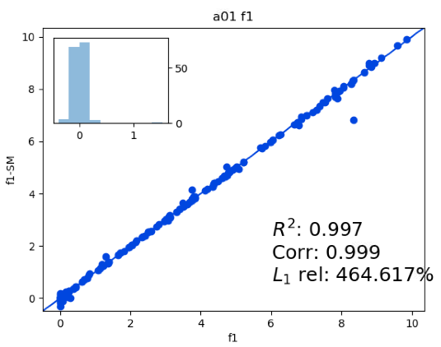
[Step 3 cont.] hill_surrogate.py produces convergence plots
The surrogate model script outputs a convergence plots for each experiment in order to
check the accuracy of the surrogate model. The convergence plot is showing the
performance of the surrogate model on the test set of data {a,b,c}_{test} that we held out.
R² should be close to 1, indicating the variance between
the model and the data is small.
Correlation close to 1 means strong positive correlation.
L1 relative error: Sum(|(f1-SM)/f1|)*100.0
Surrogate models are saved separately
for each experimental value (at different
values of x) in binary files,
e.g.: hill_a01_gpr.model
Surrogate output
Hill output
Remember x is fixed. So each saved surrogate model aims to predict the Hill function
in {a,b,c} space at a particular value of x.

Slide 31
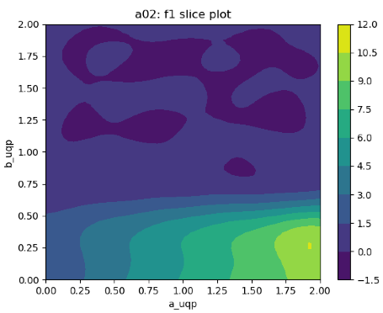
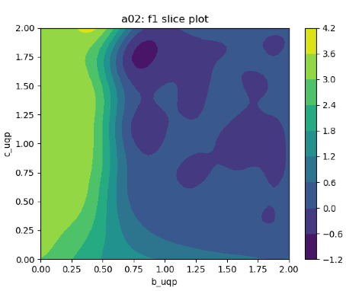
[Step 3, cont.] hill_sm_plot.py creates 2D slice plots of the Hill surrogate model to compare with the analytic slices from slide 11
Surrogate model
Analytic Hill function
slices from Slide 11
The comparisons are similar,
but not identical, indicating the
function is a challenge to fit,
even at a fixed x value.

Slide 32
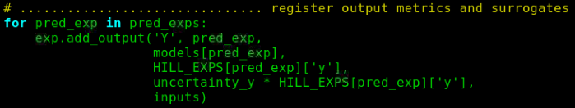
[Step 4] Set up the MCMC simulation (hill_anal_mcmc.py)
Now that we have our surrogate model for each experiment, it is time to use MCMC to sample the (likelihood)(prior)
and determine the posterior distribution. The key steps for MCMC are as follows:
1) Tell the MCMC algorithm about your input parameter bounds and sigmas:
(This sigma controls MCMC acceptance rate)
2)Tell the MCMC algorithm about your outputs, surrogates, and the experimental measurements:
Loop over all experiments
Output var
Surrogate model name
Measurement
Measurement
uncertainty
Input variables
The MCMC model assumes a form for the likelihood function. How do we change it?
The default is likely a product of Gaussians …

Slide 33
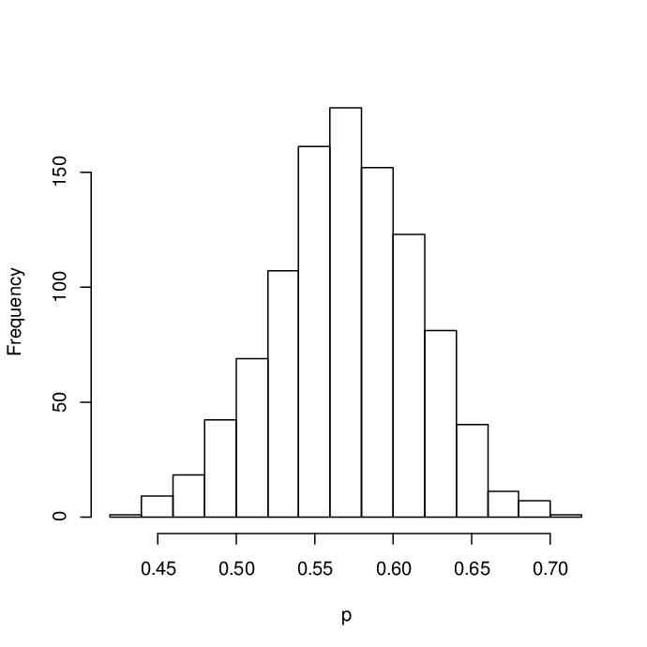
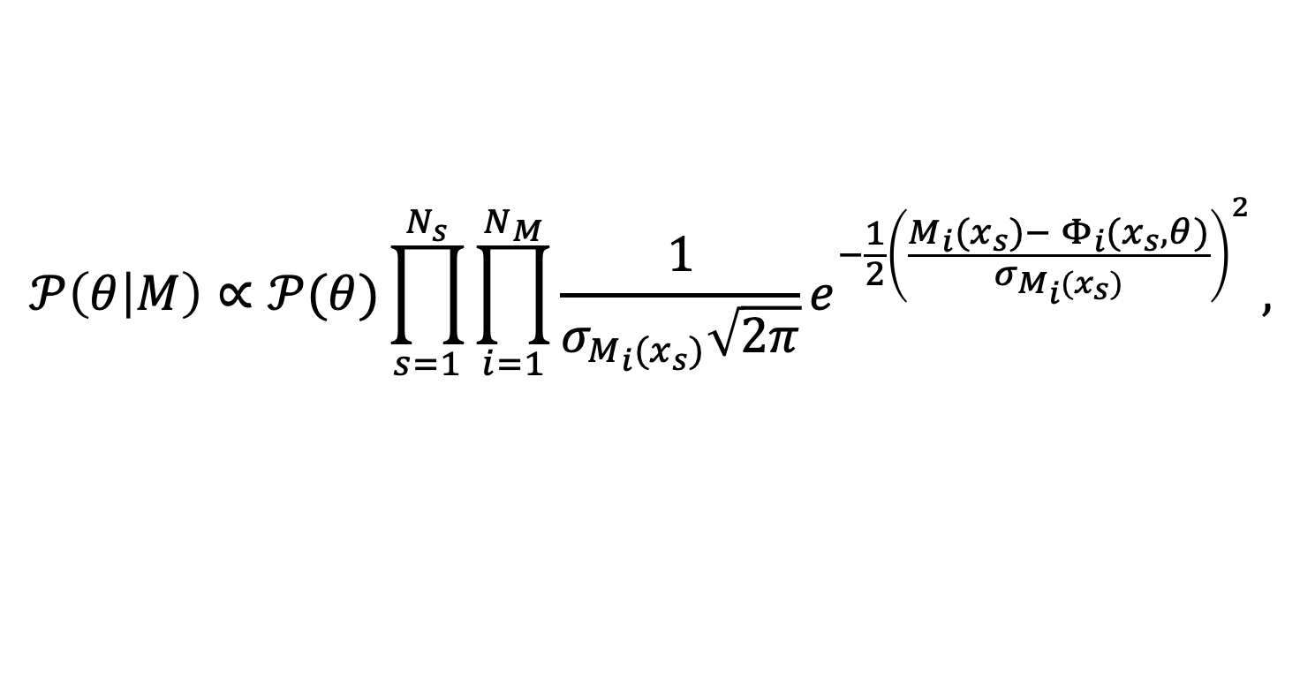
[Step 4, cont.] hill_anal_mcmc.py: MCMC sampling of the (likelihood)(prior) via the surrogate model produces the posterior
(surrogate) model prediction
at a given value of x for
parameter set ={a,b,c}.
Measured value at
a given value of x
Posterior ∝ (Likelihood)(Prior):
$$𝒫\left(θ | M\right)∝𝒫(θ)\prod_{s=1}^{N_{s}}{\prod_{i=1}^{N_{M}}{{\frac{1}{σ_{M_{i}(x_{s})}\sqrt{2π}}e}^{−\frac{1}{2}{\left(\frac{M_{i}(x_{s})− Φ_{i}(x_{s},θ)}{σ_{M_{i}(x_{s})}}\right)}^{2}}},}$$
MCMC sampling
Prior
Posterior
Measured error
Product over
all experimental
setup variations
Product over all
experimental data
for each setup
variation
Frequency
One can either perform the sampling with the Metropolis algorithm by
sampling/rejecting all parameters {𝜃} at once or one-at-a-time
(See Gibbs Sampling). [See Francisco Beltran’s MCMC talks.]
𝜃

Slide 34

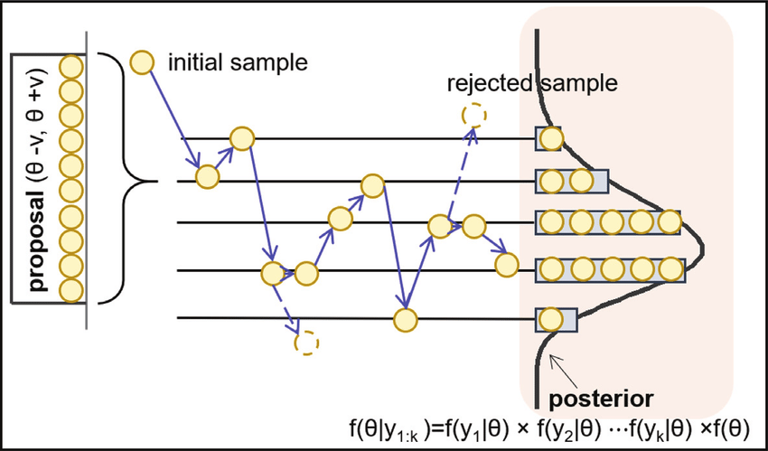
[Step 4] hill_anal_mcmc.py: Introduction to MCMC
A Random Walker
https://www.intechopen.com/books/
fault-detection-diagnosis-and-prognosis
Rejected step
Markov Chain
accepted
steps
Phase space
Random walker(s) explores phase space, collecting statistics of the distribution.
The walker takes steps of random size, which may be rejected based on probability.
Thus, there is an accept/reject rate for the steps taken.
Not all steps are independent; There is an effective number of independent steps.

Slide 35
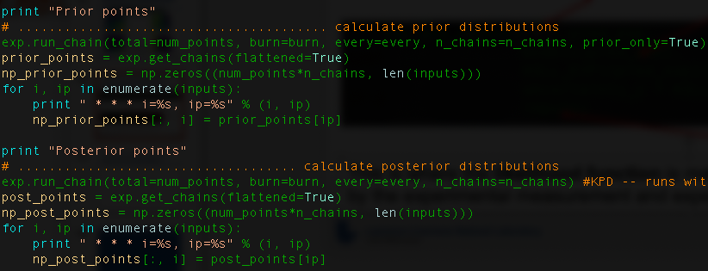
[Step 4, cont.] hill_anal_mcmc.py: samples the (likelihood)(prior) distribution to give the posterior distribution
We do two MCMC sampling simulations:
1)prior-only sampling to calculate prior distributions
2)Sample (likelihood)(prior) to calculate the posterior distributions

Slide 36
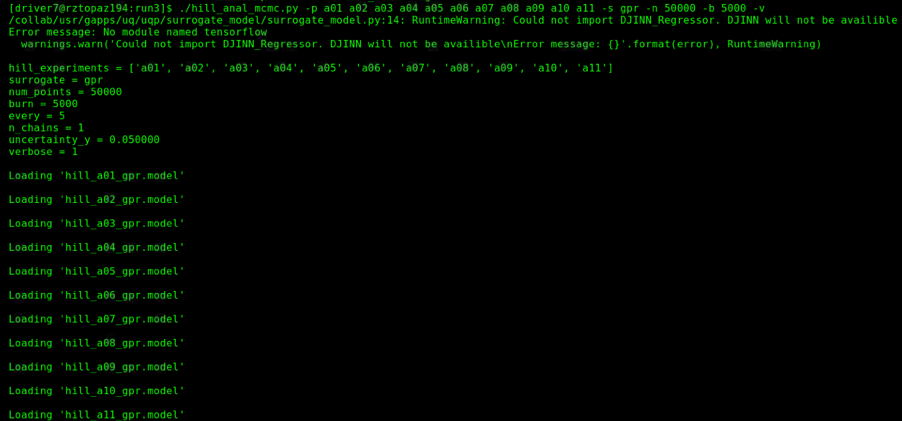
[Step 4, cont.] hill_anal_mcmc.py: Run MCMC and let’s look at the command-line output
Run MCMC:
Command-line output:
We’re sampling gpr surrogate models for all experiments.
50,000 MC iterations (walker steps)
5000 burn steps (to equilibrate the chain)
Take a sample every 5 steps to avoid correlations
1 chain
N_{iterations}=(burn+total∗every)∗nchains
Loading all the surrogate models for each experiment
(i.e., constructing the Likelihood)

Slide 37
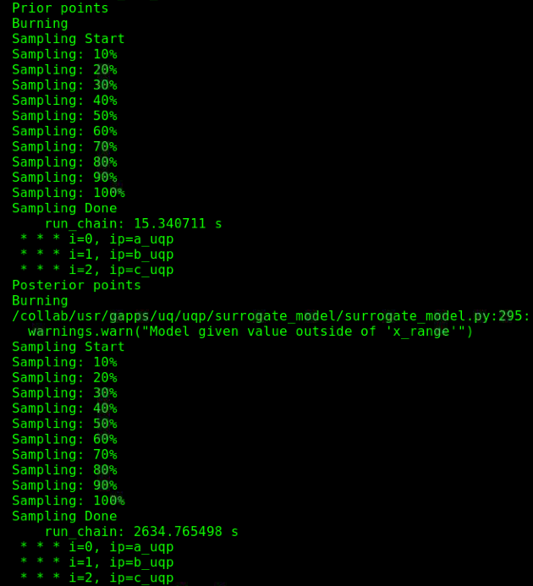
[Step 4, cont.] hill_anal_mcmc.py: Run MCMC and let’s look at the command-line output
Command-line output:
Sampling the prior distribution
Watch for warnings about overflow:
This means the MCMC started in a bad state; It will take
many iterations to locate the desired sample space.
Restart and try again.
Sampling the posterior distribution

Slide 38
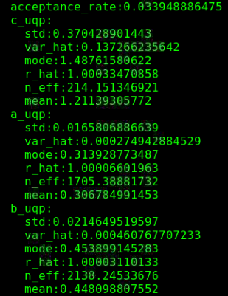
[Step 4, cont.] hill_anal_mcmc.py: For a robust MCMC simulation, check three things: acceptance rate, trace convergence, equilibration (burn-in)
Command-line output:
Aim for ~0.25 acceptance ratio
for ergodic sampling. My rate is
too low here.
r_hat should be small (~1);
it measures ergodicity.
N_eff –- effective sample
size -- should be large,
indicating sample
independence (low
autocorrelation). Should
be ~2000 in a good run.
Notice c_uqp’s Neff is too low.

Slide 39
[Step 4] hill_anal_mcmc.py: Examine the the MCMC output plots
Running hill_anal_mcmc.py will produce 13 plots:
MCMC plots to check convergence properties
1)Log plot of the posterior probability showing convergence of the MCMC
2-4)MC trace plots to check convergence of the MCMC chain
5-7)Auto-correlation plots to further check convergence of the MCMC chain
Posterior plots:
8-10)The resulting posterior and prior distribution plots
11-13) Contour plots showing correlation among the model parameters.
In the next few slides, we will study each of these plots and discuss their significance.

Slide 40
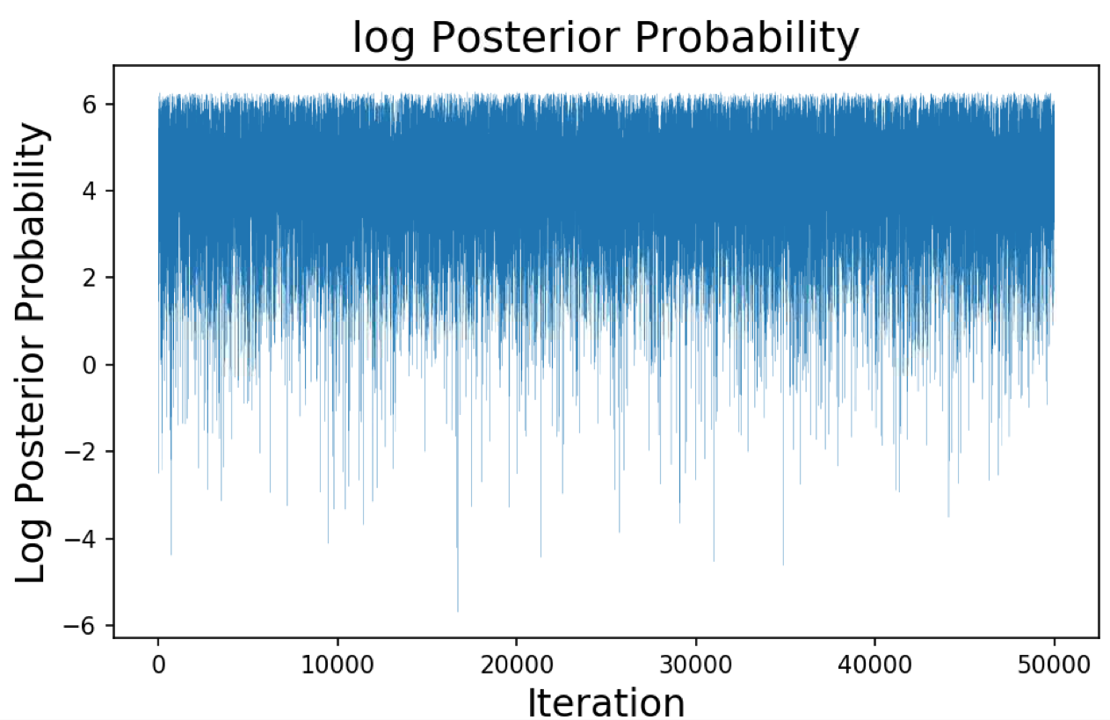
[Step 4] hill_anal_mcmc.py: log of the posterior probability
This plot shows the posterior probability as a function of the MC iteration.
The probability is high when the {a,b,c} configuration is in a good state space.

Slide 41
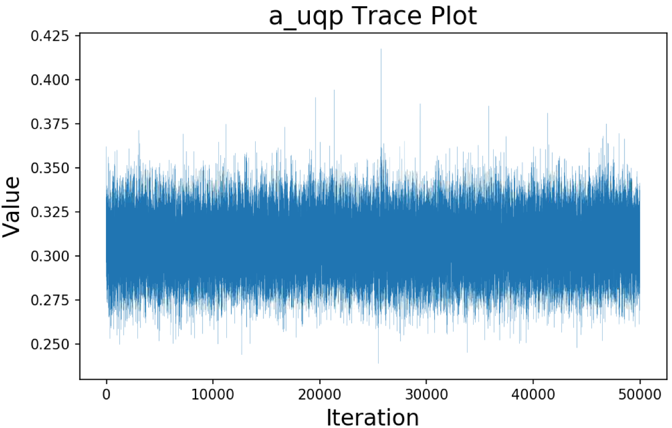
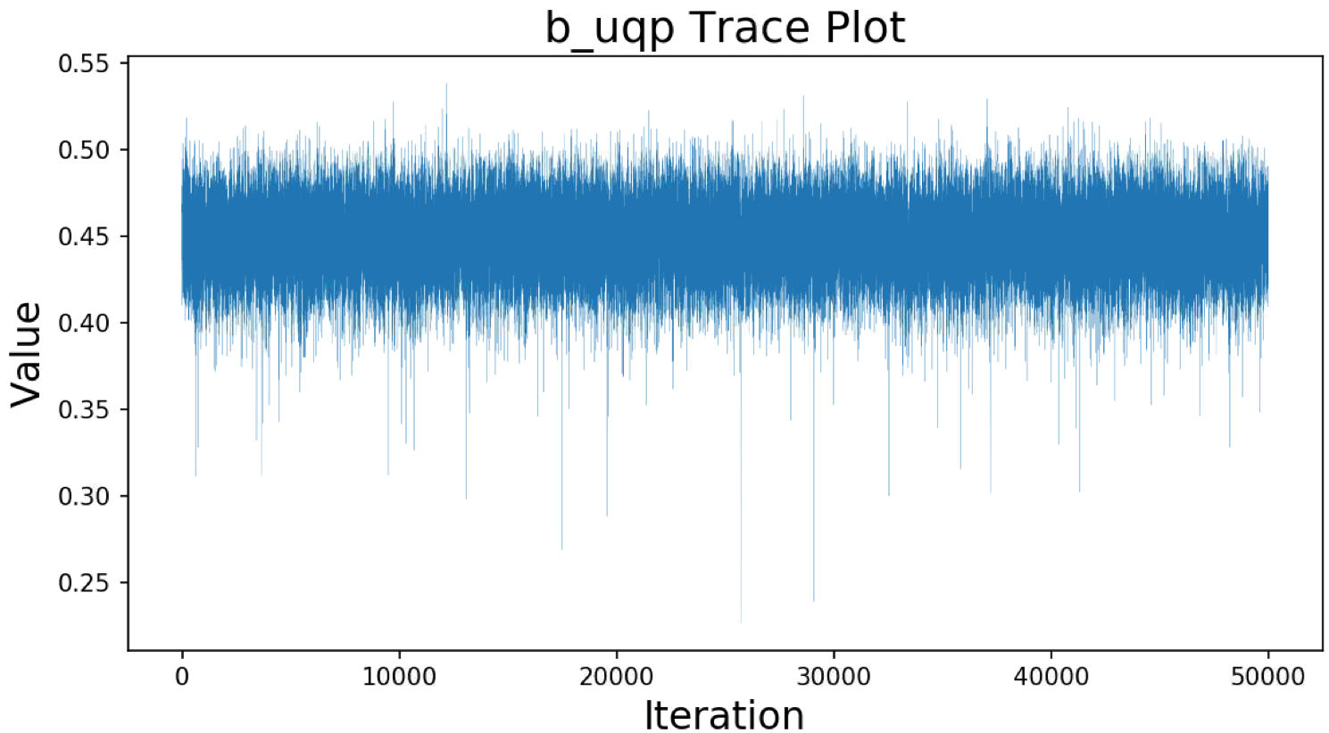
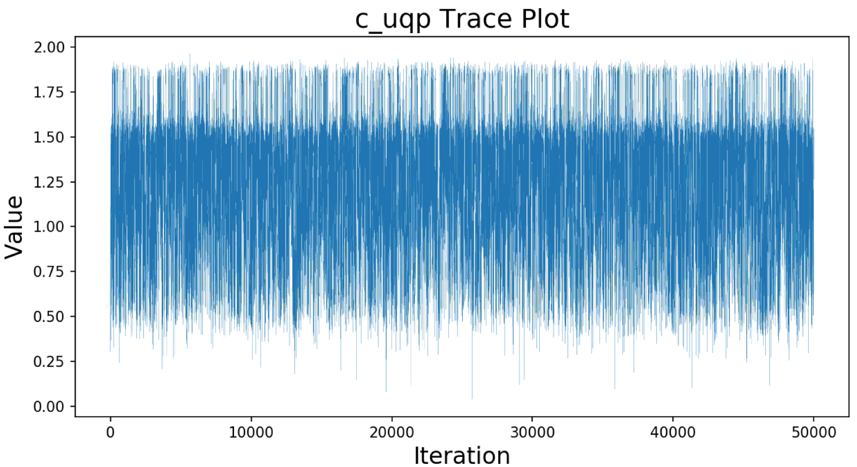
[Step 4] hill_anal_mcmc.py: Check MCMC parameter traces for equilibration and a stationary state
Is our MC chain converged to a stationary distribution? We check the trace plots
to answer this question. The trace plot shows the history of a parameter value
across iterations of the chain. If the chain is “stationary” it will not show wandering,
long-term trends; the average value of the chain should look flat to the eye.
If you see long-term, wandering trends, the step size may be too small. Here,
c_uqp looks unconverged relative to the a_uqp and b_qup traces:

Slide 42



[Step 4] hill_anal_mcmc.py: Check MCMC parameter traces for stationary state, equilibration, and autocorrelation for sufficient lag between samples
Auto-correlation measures how dependent the current value of the MC chain is on
past chain values (Lag). In an efficient chain, with a stationary distribution, the
auto-correlation should go to zero in a small number (~10s) of steps. This ensures
that our chain is maximizing the effective sample size in the MC chain.
The autocorrelation for c_uqp is clearly not optimal. This is consistent with the
other poor convergence diagnositics for c_uqp.

Slide 43



[Step 4] hill_anal_mcmc.py: plots of the prior and posterior
Here we plot the probability distribution of the resulting posterior compared to the prior
distribution (i.e. the updated parameter uncertainty distribution that has been informed
by experimental data vs. our original belief of the parameter uncertainty distribution.)
The posterior distribution should be narrower and more well-defined than the prior. Here,
we see this is the case, but the posterior for c_uqp is not well-converged (consistent with
our MCMC convergence plots).
posterior
posterior
posterior
prior
prior
prior

Slide 44



[Step 4] hill_anal_mcmc.py: contour plots to show correlations among the posterior parameters
The posterior contour plots are made from 2D histograms, computed by grouping
the sets of data points (a,b) into bins according to their coordinates, and keeping
a count of the frequency in each 2D bin to compute the color of a tile. The brighter
regions tells us which pairs of parameters were sampled from the joint distribution
most frequently, and hence show correlations in the parameters.
We can see the plots with c_uqp are less well-defined since this parameter
is bi-modal.

Slide 45


[Step 4, cont.] Guidelines for MCMC convergence
1) Use a large number of MC steps. Error ~1/sqrt(N_{MC})
2) Adjust Acceptance Rate; check trace
Aim for an acceptance rate of 0.25. If the
acceptance rate is too low (high), decrease (increase)
the walker’s step size (i.e., sigma). When the step
size is good, the trace will look “stationary”
with a well-defined average.
3) Adjust “every” – adjusts the frequency at which a sample is saved. Together
with a good acceptance rate, this will ensure a large effective sample size (i.e. a
large collection of independent samples, Neff)
4) Check autocorrelation : Adjust
“every” such that it corresponds roughly
to the number of steps where the
autocorrelation goes to zero.
e.g.: roughly 20 steps
needed to decorrelate
saved samples

Slide 46


[Step 4, cont.] Guidelines for MCMC convergence
5) Check the value of :
It is a measure of variance within and between chains.
A value near 1 indicates the walker has explored thoroughly explored phase space.
A value of r>1 indicates the walker has not visited all of phase space and the
distribution is therefore not converged.
6) Check the value of Neff (effective independent sample size)
This value should be large >2000, reflecting your autocorrelation lag is low and your
total number of MC iterations (walker steps) is high. It indicates that your result is based
on a large number of independent samples.
7) Visually inspect the posterior distribution plots
$$\hat{r}$$
posterior
The posteriors and prior distributions should look smooth and well-behaved. Though it is possible that some are multi-modal even for a likelihood comprised of a product of Gaussians.
prior

Slide 47
[Step 4, cont.] Example of acceptance rate tuning
Burn 10000; Run 500 MC iterations to systematically study the rate at which proposed configurations {a,b,c} are
accepted. We want an acceptance rate of ~0.25 for optimal efficiency in sampling (MCMC expert lore).
aStepSize | bStepSize | cStepSize | Acceptance rate | note
0.10 | 0.10 | 0.10 | 0.04 | Steps too big
0.01 | 0.01 | 0.01 | 0.71 | Steps too small
0.04 | 0.04 | 0.04 | 0.23 | Good
0.06 | 0.04 | 0.04 | 0.16
0.04 | 0.06 | 0.04 | 0.17
0.04 | 0.04 | 0.06 | 0.22 | Insensitive to c
0.02 | 0.04 | 0.04 | 0.33
0.04 | 0.02 | 0.04 | 0.30
0.04 | 0.04 | 0.02 | 0.23 | Insensitive to c
0.01 | 0.01 | 1.0 | 0.27 | not fair since all phase spaces are similar
0.035 | 0.035 | 0.2 | 0.23 | Better?
A larger cStepSize is allowed because c has a largest phase space and multiple values of c (controls the slope)
can fit the data. At the end of the day, all of these choices will converge with enough statistics, but some faster than others.

Slide 48









[Step 4] MCMC convergence study: Run #1 – a very underconverged run
Fixing:
Seed: 20201019
Start config: {0.25, 0.50, 1.20}
N_{MC}=500, N_{burn}=10000, N_{every}=10; sigmas={0.03, 0.03, .08}, AcceptRate=0.3
A) Trace plots are not stationary (wandering trace without a clear mean)
B) Posteriors are noisy
posterior
posterior
posterior
prior
prior
prior
C) Autocorrelation never goes to zero
C) r-hats={1.0,1.0,1.26} => c too high; Neffs={87,190,3} => all way too low

Slide 49









[Step 4] MCMC convergence study: Run #2 – a slightly underconverged run
N_{MC}=10000, N_{burn}=10000, N_{every}=10; sigmas={0.03, 0.03, .08}, AcceptRate=0.3
A) “a” and “b” traces shows a stationary state; trace c is still not stationary (c is the difficult parameter)
B) Posterior for a and b look converged; c is still noisy
posterior
posterior
posterior
prior
prior
prior
C) Autocorrelation now reduces to zero, but lag is much larger than N_{every} we are using.
D) r-hats={1.0,1.0,1.0} => good; Neffs={3025, 2851,283} => c still very low

Slide 50









[Step 4] MCMC convergence study: Run #3 – a slightly underconverged run
N_{MC}=10000, N_{burn}=10000, N_{every}=30; sigmas={0.03, 0.03, .08}, AcceptRate=0.3
A) The c trace looks better, but still not a clear stationary state
B) Posterior for c is still a bit noisy
posterior
posterior
posterior
prior
prior
prior
C) Autocorrelation looks good. In each case, it goes to zero at lag values > N_{every}.
D) r-hats={1.0,1.0,1.0} => good; Neffs={5088, 5568, 1000} => c Neff is on the edge

Slide 51
[Step 4] MCMC convergence study: Run #4 – converged run
N_{MC}=50000, N_{burn}=10000, N_{every}=30; sigmas={0.03, 0.03, .08}, AcceptRate=0.3
A) Traces are now all stationary
B) Posteriors looks smooth and well converged
posterior
posterior
posterior
prior
prior
prior
C) Autocorrelation all reduce to zero with N_{eff} > lag0
D) r-hats={1.0,1.0,1.0} => good; Neffs={26000, 29000, 4200} => good

Slide 52






[Step 4] MCMC convergence study: Run #5 – very converged run (parallel batch for speed)
N_{MC}=10000, N_{burn}=10000, N_{every}=30; Nchains=16, sigmas={0.03, 0.03, .08}, AR=0.3
A) Posteriors are well converged
B) Correlation plots
D) r-hats={1.0,1.0,1.0} => good; Neffs={82000, 97000,14000} => good

Slide 53
Parallelizing MCMC over Markov chains – Issues and bugs: scaling
User time can be significantly reduced by running multiple chains in parallel (strong scaling).
It is also the easiest way to ramp up N_{MC} iterations for convergence (weak scaling).
Issue #1: the parallel scaling (weak and strong) can be improved:
Plot shows speedup vs. number of
chains parallelized in a batch run on a
rztopaz node (36 cores available).
Each chain takes 1 core. This is a
weak scaling study – iterations per
core is fixed and the total problem size
grows with more chains/cores.
The chains are independent, but
currently bottlenecked by accessing
one copy of the surrogates in
shared memory instead of each
node getting its own copy. More complex
surrogates are a bigger bottle neck.

Slide 54


Parallelizing MCMC over Markov chains – Issues and bugs: random initialization in batch has a bug
Issue #2: Random seed/start in batch has a bug. Starting with the same set of Hill surrogates, I repeated 4 MCMC
runs using 1 chain in batch mode and found excessive variability among the results.
(each run was allowed to randomly choose its own seed and starting config)
Acceptance rates are vastly different:
All runs used 50,000 burn, 50,000 MC steps, every=15, chains=1:
Running interactively or fixing the seed & starting config in batch bypasses the bug:

Slide 55
Another current issue with MCMC is that an initial random MCMC configuration is often poorly chosen
Issue #3 :The initial posterior sample point is frequently a problem.
Three scenarios appear:
1) No warning => MCMC starting point is ok (rare)
2) The initial configuration is generated outside of the surrogate model’s range (often)
3) Starting config causes an overflow error (rare) (This always results in terrible MCMC
results – maybe just make the code die if this happens? If the user doesn’t look for this
warning they won’t know why their results are so bad.)
These issues are currently being investigated and fix by developers

Slide 56





[Step 5] hill_anal_post.py: Prior and Posterior predictive distributions
Now that we have constructed the posterior distribution, $𝒫\left(θ | M\right),$ using MCMC, we
can use it to predict the distribution of a data point with an error bar that fully accounts
for the uncertainty in our parameters, which has been updated by the experimental data.
$$\left\langle f(x)\right\rangle =\int{f\left(x\right)ρ\left(x\right)dx},$$
Recall, the average value of some function, f(x), is
where 𝜌(x) is the probability density function of x. Similarly, we average over
all possible parameter values, weighted by the posterior or prior to get predictives:
Prior Predictive (data prediction based on the prior only)
$$p(\tilde{m})=\int{p\left(\tilde{m} | θ\right)𝒫(θ)dθ},$$
where $\tilde{m}$ is a new data point.
Posterior Predictive (data prediction based on the posterior distribution)
$$p\left(\tilde{m} | M\right)=\int{p\left(\tilde{m} | θ\right)𝒫\left(θ | M\right)dθ},$$
Our surrogate model evaluated for all the posterior or prior points
easily computes these predictions for us.

Slide 57


[Step 5, cont.] hill_anal_post.py: Prior and Posterior analysis
The posterior analysis script performs the predictive calculations for each
experimental data point, and shows the results in a box and distribution plot:
Predicted data distribution using the prior vs.
the posterior along with confidence intervals.
The uncertainty in the posterior prediction is
much smaller due to experimental information.
Box plots of predicted experiment using
the prior vs posterior. The line in the box
is the median.

Slide 58

[Step 5, cont.] hill_anal_post.py: Examine how well our inference parameters fit the Hill function “drive curve”
Now one can compare posterior predictions with the experimental data curve by
evaluating the Hill function with samples from the posterior for a range of x values.
This is equivalent to sampling the posterior predictive for a range of x values.
The white x’s are the experimental data.
The red curve is the Hill function
evaluated at mean posterior values
The color bar is a histogram of the
hill function evaluated at all of the
posterior points for a range of x values, which
shows the total uncertainty on our model
prediction for the curve.

Slide 59
Future Applications

Slide 60

Goal: Perform UQ analysis of the HED Sonoma campaign experiments: constrained radiation flow
5 Sonoma shots were
Performed on NIF:
0% blocking washer
25%
37.5%
50%
62.5%
Supersonic SiO₂ annulus
with Ta₂O₅ walls
rad flow
We will use this experimental
data to do a UQ analysis
0% blocked
50% blocked
Gold/silicon
blocking washer:
25 μm thick:
Si 20 μm
Au 5 μm

Slide 61






HED UQ: Sonoma “Supercharged” radiation flow
Inverse
Bremsstrahlung
x-rays
Laser
$$α_{wall}^{heated}$$
$$α_{wall}^{cold}$$
Curved Marshak
Heat Front
Wall albedo increases with T:
Hot,
bleached
foam
$α∝$1 - $\frac{1}{T^{m}{(κ_{0}t)}^{n}}$
x-rays
Cold
foam
Blocking washer constrains rad flow
Supercharged
The wall heating rate, via the albedo, has
significant control over the speed of the
Marshak wave. Constraining the strength of
rad source via a block washer will eventually
lead to failure of the rad flow breakout.
Cold wall

Slide 62



Currently learning run Kull and apply UQP components on a simplified geometry
Hohlraum (19.32 g/cc)
Coverage = 0%
Ta₂0₅ ( 0.20 g/cc)
Heated
wall
Cold
wall
SiO₂ (0.02 g/cc)
Marshak
heat front
Coverage = 50%
Supersonic Marshak
wave breakout
Potential UQ parameters
Foam densities (Ta₂O₅ , SiO₂ )
Ta₂O₅ washer coverage (0-100%)
Ta₂O₅ wall thickness
Laser power
Synthetic
Dante-2
flux

Slide 64

Pictorial illustrations of Bayesian modeling
In the free online textbook, “Gaussian Processes for Machine Learning,” by C. Rasmussen and C. Williams,
they provide a helpful pictorial image for Bayesian modelling that I reproduce here.
http://www.gaussianprocess.org/gpml/
Prior
samples
Posterior
samples
Prior
samples
Take
Data
Posterior
(updated prior)
samples
The posterior combines the likelihood (parameterized by observed data), and the prior,
and, hence, captures everything we know about the parameters.

Slide 65



3D Gaussian pictorial illustration of Bayesian modeling
If the prior is significantly different than the Likelihood, then the posterior peak will
significantly shift away from the experimental.
Likelihood
Prior
Posterior
∝
y
y
x
y
x
x

